Slide 1
Digital Marketing With Data Science How Data Drives Successful Marketing Strategies
By
Kishor
Register No : 2448314
Guide : Dr. Jayapriya
1

Slide 2
Introduction of DM
Conclusion
Q&A
Importance
Of DM
Data Visualization
Digital
Marketing
Analysis
Types Of Digital Marketing
Predictive Analytics
Role of Google Analytics
Email Marketing Data
Social
Media Analytics
2

Slide 3

Types Of
Digital
Marketing
What is Digital Marketing ?
Importance of
Digital
Marketing
Digital marketing refers to the use of online channels, strategies, and technologies to promote products or services.
Search Engine Optimization (SEO)
Pay-Per-Click Advertising (PPC)
Social Media Marketing
Email Marketing
Content Marketing
Conclusion
Q&A
Data
Visualization
3

Slide 4

Role of Google Analytics
Types Of
Digital
Marketing
Importance of Data in Digital Marketing
Understanding customer behavior.
Optimizing campaign performance.
Measuring ROI (Return on Investment).
Improving customer targeting and personalization.
Data is crucial for making informed marketing decisions.
Introduction
to Digital
Marketing
Conclusion
Q&A
4

Slide 5

Social
Media
Analytics
Types Of Digital Marketing Data
Role of Google Analytics
Digital marketing relies on different types of data
Website Data
Social Media Data
Email Data
Advertising Data
Customer Data
Importance of
Data in Digital
Marketing
Introduction
to Digital
Marketing
5

Slide 6
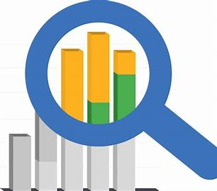
Email
Marketing
Data
Role of Google Analytics
Social
Media
Analytics
Google Analytics is a powerful tool that provides insights into website performance
User behavior
Traffic sources
Conversion tracking
Bounce rate
Types Of
Digital
Marketing
Importance of
Data in Digital
Marketing
6

Slide 7
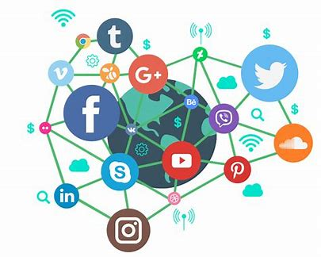
Predictive
Analytics
Social Media Analytics
Email
Marketing
Data
Social media platforms provide analytics to measure engagement and effectiveness
Follower growth
Engagement metrics
Reach & impressions
Social listening
Best tools
Role of Google Analytics
Types Of
Digital
Marketing
7

Slide 8

Data
Visualization
Email Marketing Data
Predictive
Analytics
Email marketing remains one of the most effective channels.
Open Rate
Click-Through Rate (CTR)
Conversion Rate
Bounce Rate
Personalization & Segmentation
Social
Media
Analytics
Role of Google Analytics
8

Slide 9

Challenges in
Data-Driven
Marketing
Predictive Analytics in Marketing
Data
Visualization
Predictive analytics uses data and AI to forecast future customer behavior.
Customer segmentation
Personalization
Churn prediction
Optimized ad targeting
Email
Marketing
Data
Social
Media
Analytics
9

Slide 10

Future of Data
Driven
Marketing
Data Visualization in Marketing
Challenges in
Data-Driven
Marketing
Marketing data should be easy to interpret.
Dashboards & reports – Real-time performance tracking.
Tools – Google Data Studio, Tableau, Power BI.
Charts & graphs – Helping marketers make data-driven decisions.
Predictive
Analytics
Email
Marketing
Data
10

Slide 11

Conclusion
Q&A
Challenges in Data-Driven Marketing
Future of Data
Driven
Marketing
Data Privacy & Compliance
Big Data Management
Analysis Paralysis
Ad Fraud & Bot Traffic
Data
Visualization
Predictive
Analytics
11

Slide 12

Introduction of
Digital Marketing
Future of Data Driven Marketing
Conclusion
Q&A
AI & Automation
Voice Search & Smart Assistants
First-Party Data Strategies
Augmented Reality (AR)
Virtual Reality (VR)
Challenges in
Data-Driven
Marketing
Data
Visualization
12

Slide 13

Importance
Of DM
Conclusion
Introduction of
Digital Marketing
Digital marketing success relies on data analysis to make better decisions.
Using tools like Google Analytics, social media insights, PPC metrics, and email data helps improve campaigns.
The future of marketing is AI-driven, personalized, and data-focused.
Future of Data
Driven
Marketing
Challenges in
Data-Driven
Marketing
13

Slide 14

Questions & Answers
14

Slide 15







